Slide 1
Chapter 1
Introduction

Slide 2
WHY YOU SHOULD LEARN ASSEMBLY
To create system software for new processors:
Compilers, Optimizers, Assemblers, Linkers, Device Drivers.
To better understand the limitations of fundamental data types:
Precision, Range, Overflow, Representation Error
To better understand high level languages:
Visualizing pass-by-value, pass-by-reference, recursion, pointers, and writing code to take advantage of memory hierarchies based on locality of reference

Slide 3
WHEN ASSEMBLY IS NEEDED
To optimize performance:
Implementing code fragments that account for most of the execution time.
Using fixed-point arithmetic when the processor has no floating-point instructions
For code not easily implemented in a high-level language:
Reversing the order of bits and bytes
Low-level access to hardware resources:
Device drivers, interrupt routines.
Reverse engineering to understand and eradicate malware

Slide 4
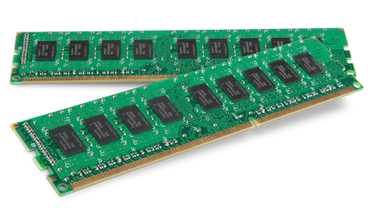
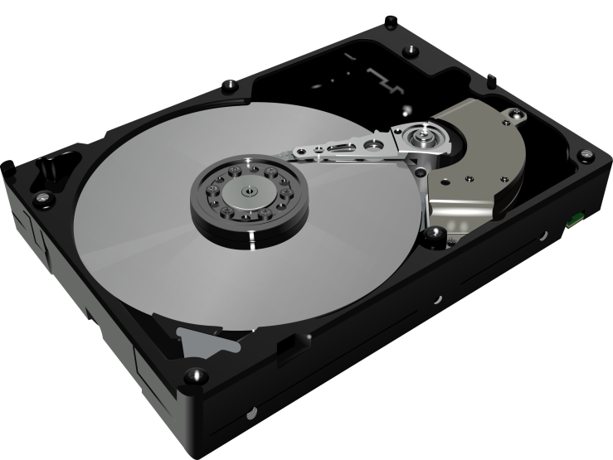
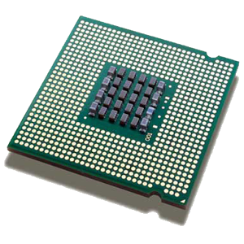
COMPUTER COMPONENTS
Registers
(16 x 32-bits)
nanoseconds
(10⁻⁹ sec)
microseconds
(10⁻⁶ sec)
Arithmetic and Logic Unit (ALU)
Main Memory
(1 GB = 10⁹ bytes)
milliseconds
(10⁻³ sec)
Control Unit
Disk Drive
(1 TB = 10¹² bytes)
Central Processing Unit (CPU)

Slide 5
Terminology
Radix
Binary
Octal
Hexadecimal
Bit (Binary Digit)
Byte
Word
Half-Word
Double-Word
Representation/Interpretation
Range
Overflow
Resolution/Precision
Unsigned
Signed
2’s complement
Sign Plus Magnitude
Memory
Address
Register
Opcode
Immediate Constant
Label

Slide 6
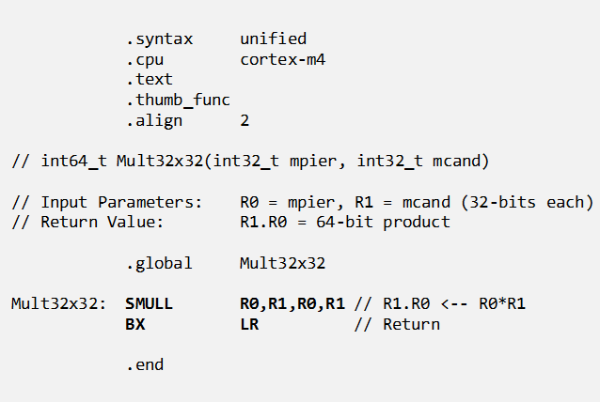
WHAT ASSEMBLY LANGUAGE LOOKS LIKE
Assembler directives
Comment lines
Label
Executable Instructions
Instruction Mnemonic
("OpCode")
Instruction Operands
Comments

Slide 7
HOW ASSEMBLERS WORK
Assembler Pass 1
Original source code
...
L1: LDRB R0,x+1
...
x: .byte 3,5,7
...
Pass 1: Source code is processed one line at a time, from beginning to end. A "Location Counter" keeps track of the memory address of each line and is used to enter each label and its memory address into a "Symbol Table".
Location Counter
Label addresses determined
...
1234 LDRB R0,x+1
...
4764 .byte 3,5,7
...
Symbol Table
Assembler Pass 2
Identifier | Relative Address
L1 | 1234
x | 4764
Pass 2: Source code is processed a second time, starting over at the beginning. Instruction mnemonics are replaced by their binary coded representation, using the symbol table to replace each label reference by its corresponding memory address.
Label references resolved
...
1234 LDRB R0,[#4765]
...
4764 .byte 3,5,7
...

Slide 8
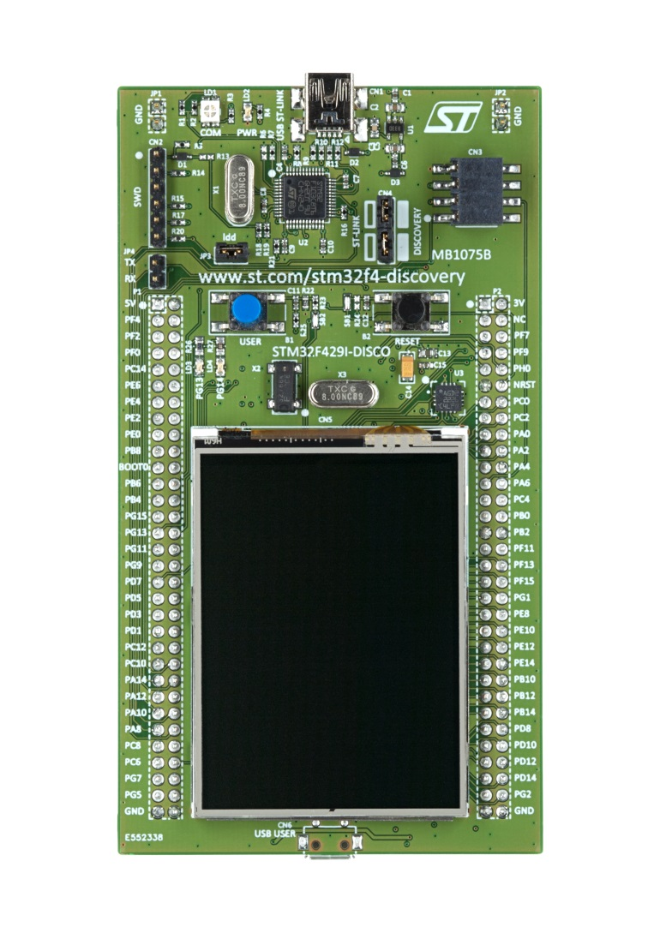
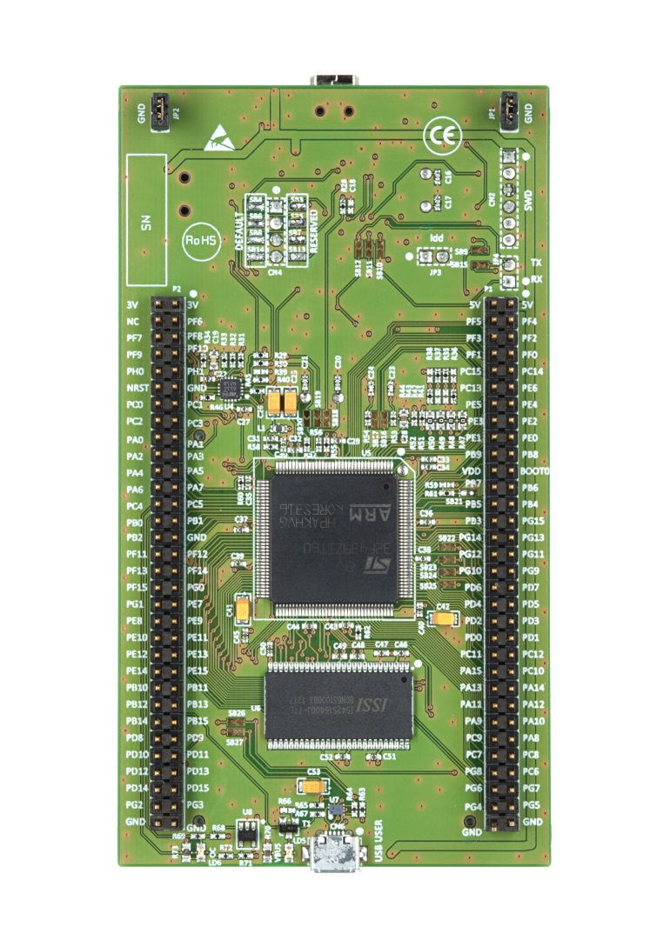
HARDWARE ENVIRONMENT STM32F429ZI Discovery Board
Front View
Rear View
USB connector for power and downloading code
ARM Cortex-M4F:
180 MHz 32-bit CPU
2MB of flash memory
256KB RAM (variables)
3-axis Gyroscope
FPU & DSP Instructions
CRC32 hardware
Programmable push button
Reset button
Touch-sensitive color display
240x320 pixels
USB connector for thumb drive

Slide 9
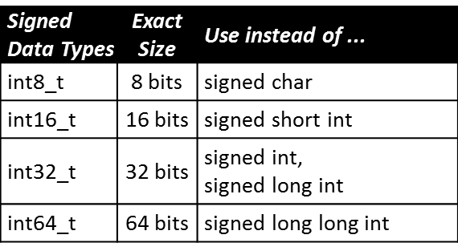
Signed Integer Data Types

Slide 10
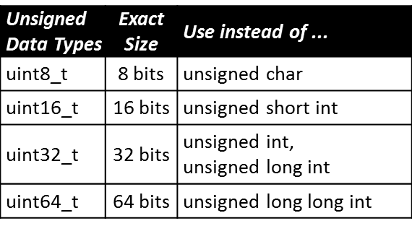
Unsigned Integer Data Types

Slide 11
IDENTIFIER CONVENTIONS
Variable Names
All lowercase
Append digits to indicate size in bits
Prefix with ‘s’ for signed, ‘u’ for unsigned
Function Names
Capitalize 1st letter of each word
Macros and Symbolic Constants
All Caps

